Slide 1

TechHarbor Solutions Pvt. Ltd.
Python Article 1
Python and List Overview
- By Ankita Patil

Slide 2
Agenda
Introduction to Python
Why Python is popular
Python data types
List in Python
List Operations
Conclusion

Slide 3
Introduction
.
What is Python?
Python is High level,dynamically typed programming language.
Why python is popular?
Applications of Python

Slide 4
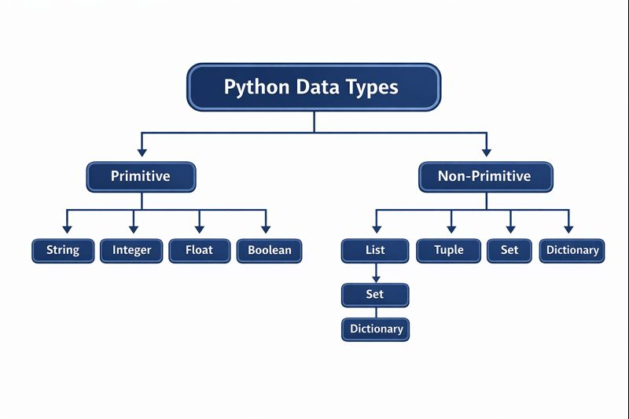
Python data types

Slide 5
List in Python
What is a List?
List is used to store multiple values in a single variable.
Real World Example :
Subjects = ["Python", "Math", "Science"]

Slide 6
List operation
append()- Add the Item
remove()-Remove the item
pop()- removing an element
update()- Update the Item
Insert()- Insert the Item
Indexing()- accessing an element

Slide 7
Conclusion
• Python basics such as data types and lists are used in almost every real-world application. Understanding these concepts helps in learning advanced Python topics easily.

